Slide 1

Simple linear regression (Catheter length)
Kevin Sutanto
m08158054

Slide 2
outline
DATA COLLECTION
DATA PREPROCESSING
HANDLING MISSING DATA (SimpleImputer)
SPLITTING THE DATASET (train_test_split)
LINEAR REGRESSION LEARNING
RESULT

Slide 3
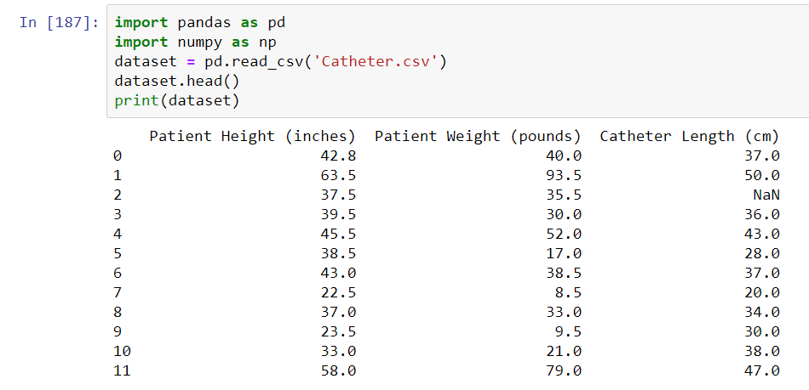
IMPORT THE Dataset

Slide 4
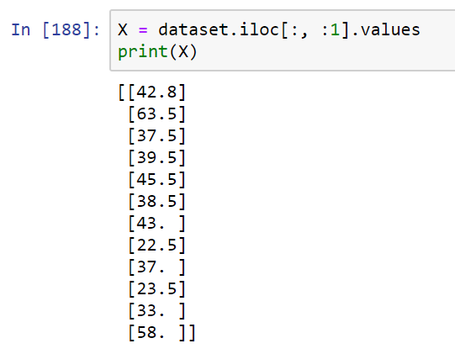
Filter dataset based on patient height

Slide 5
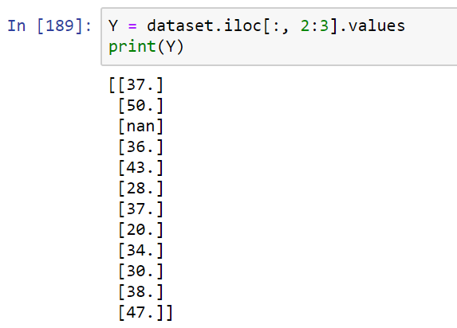
Filter dataset based on catheter length

Slide 6
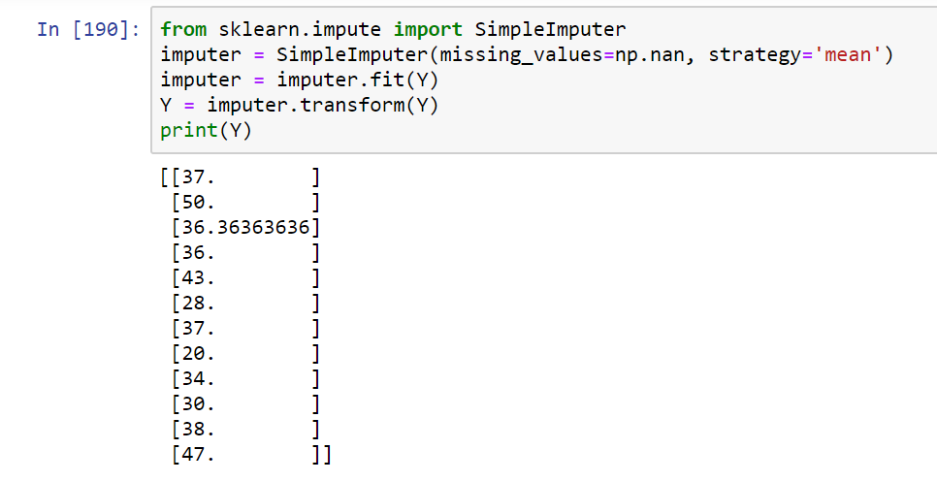
Fill missing values from dataset

Slide 7
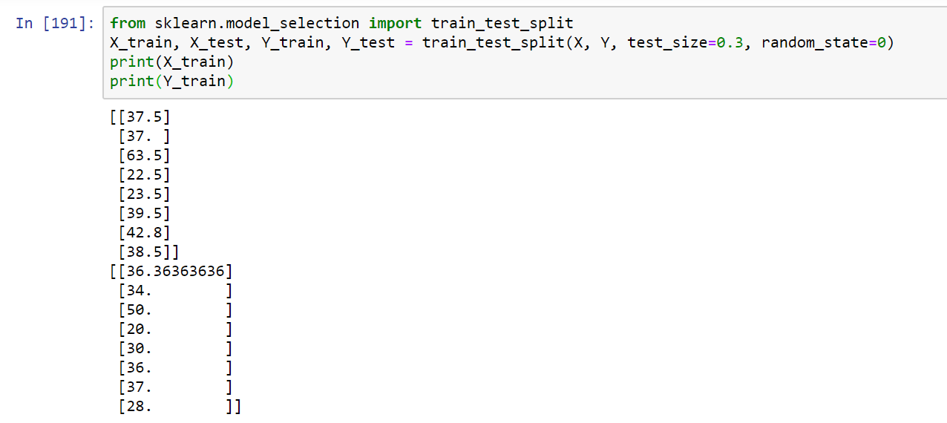
Split data train and data test

Slide 8
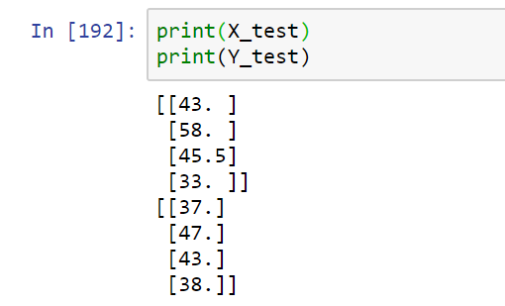

Slide 9
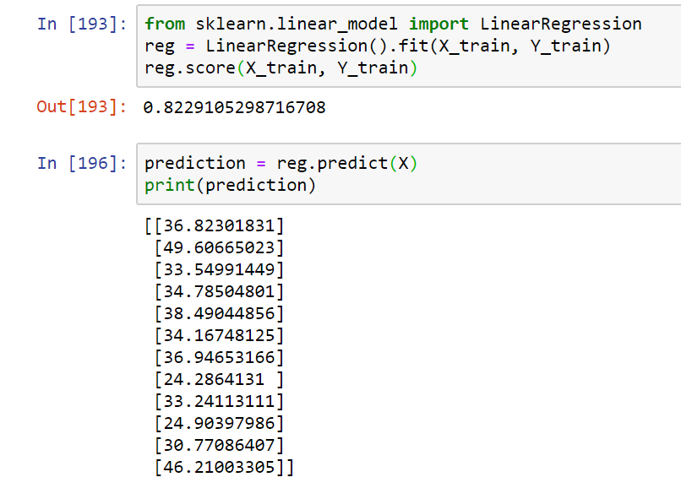
Linear regression

Slide 10
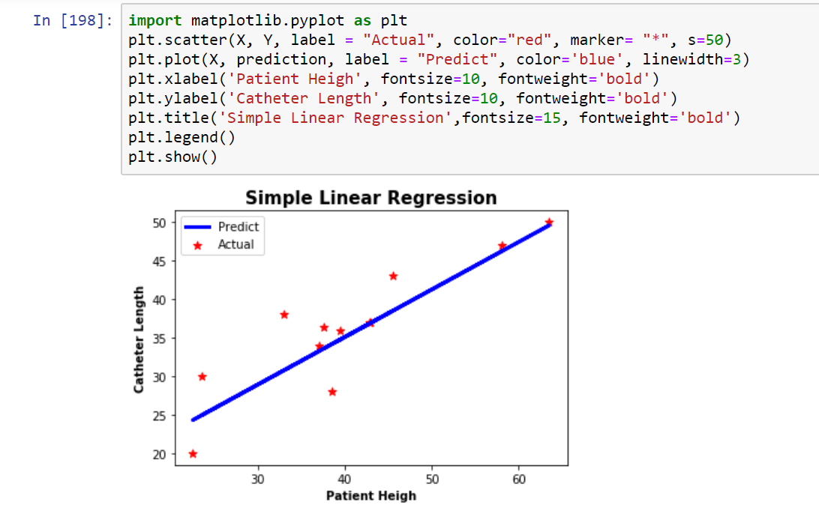
Plot Result

Slide 11


